Slide 1
SE 577 Software Architecture The Software Architecture of Linux

Slide 2
Reference
I.T. Bowman, R.C. Holt, and N.V. Brewster: “Linux as a Case Study Its Extracted Software Architecture”, Proc. ICSE ‘99, Los Angeles, CA., pp. 555-563.

Slide 3
About the Paper
Describes work done to document the software architecture of the Linux kernel
Linux kernel (~800KLOC) is responsible for:
Process management
Memory management
Hardware device management

Slide 4
Why Study This Work?
Look at an example of the architecture of a large, complex, software system.

Slide 5
Why Study This Work?
Look at an example of the architecture of a large, complex, software system.
Observe the approach used to describe/document the architecture of the software

Slide 6
Why Study This Work?
Look at an example of the architecture of a large, complex, software system.
Observe the approach used to describe/document the architecture of the software.
Understand what needs to be done to figure out the architecture of such system [extraction methodology].

Slide 7
Why Study This Work?
Look at an example of the architecture of a large, complex, software system.
Observe the approach used to describe/document the architecture of such software system.
Understand what needs to be done to figure out the architecture of such system [extraction methodology].
Point out the differences and significance between the conceptual and concrete architectures?

Slide 8
Architectural Documentation
Two types of architectural documentation:
Conceptual architecture (Prescriptive architecture)
How developers think about the system
Relationships between subsystems that are meaningful to developers
Concrete architecture (Descriptive architecture)
Relationships that exist in the implemented system.

Slide 9
Architectural Documentation (cont’d)
Architecture documentation
Individual functions and even modules are not described in detail.
Subsystems and relations between them are documented.
Architectural documentation is valuable for understanding the system.
Great help for evaluation or re-engineering efforts.

Slide 10
Architectural Documentation (cont’d)
Unless architectural documentation is maintained it will become obsolete as the system undergoes further changes.
Others have proposed work to keep architectural documentation up to date (e.g., Software Bookshelf by Finnigan, et al.)

Slide 11
Conceptual Architecture
File System
Memory
Manager
Network
Interface
Process
Scheduler
Inter-Process
Communication
Initialization
Library
Subsystem
depends

Slide 12
Conceptual Architecture (cont’d)
Diagram shows “depends-on” relationship
E.g., Memory Manager depends on the File System to swap memory to and from disk.
Each subsystem has additional subsystems hierarchically nested within it (not shown).
The Initialization subsystem depends on all other kernel subsystems (it calls initialization routines).
All the kernel subsystems depend on the Library subsystem.

Slide 13
Conceptual Architecture (cont’d)
Seven major subsystems:
Process Scheduler
Responsible for supporting multitasking by changing which user process executes.
Memory Manager
Provides a separate memory space for each user process and uses swapping to support more processes than fit in physical memory.
File System
Provides access to hardware devices. User processes can access keyboards, tape drives, hard drives, and modems using one interface that is implemented by the File System.

Slide 14
Conceptual Architecture (cont’d)
Network Interface
Encapsulates access to network devices in a similar manner to the File System. User processes can communicate with other computers using several different types of network hardware and transmission protocols.
InterProcess Communication
The IPC subsystem allows user processes to communicate with other processes on the same Computer. Synchronization memory sharing and interprocess messaging primitives are supported by the IPC subsystem.

Slide 15
Conceptual Architecture (cont’d)
Initialization
Responsible for initializing the rest of the Linux kernel with appropriate user configured settings.
Library
Contains routines which are used throughout the kernel.

Slide 16
File System Conceptual Architecture
Three main roles:
Provide access to a wide variety of hardware devices.
Support several different logical file system formats that control how files are mapped to physical locations on hardware devices.
Allow programs to be stored in several executable formats including interpreted scripts.

Slide 17
File System Conceptual Architecture (cont’d)
IPC
Network Interface
Memory
Manager
System Call Interface
Executable File Formats
Executable File Formats
Virtual File System
Logical File Systems
Logical File Systems
Device Drivers
File Quota
Buffer Cache
File Quota
Process Scheduler
Initialization
Library

Slide 18
The File System
Five subsystems implement the main roles of the File System:
Device Drivers
Perform all communication with hardware devices supported by Linux.
Logical File Systems
Implement several logical file systems that can be placed on hardware devices; these different file systems allow interoperability with different operating systems and also allow specialized functionality such as encryption compression and high performance.

Slide 19
The File System (cont’d)
Executable File Formats
Allow clients to execute programs from several different executable file formats including not only compiled programs but also interpreted scripts.
File Quota
Allow system administrators to limit the amount of file storage that individual users may use.
Buffer Cache
Provide memory buffers for input/output operations and reduces hardware accesses by caching data and eliminating redundant reads and writes.

Slide 20
The File System (cont’d)
Unexpected relationships from Conceptual architecture:
Device Drivers ➔ Process Scheduler
A device driver might request to be suspended while waiting for i/o to complete.
Logical File System ➔ Network Interface
Some logical files are stored on another computer and accessed using the network.
Memory Manager ➔ Virtual File System
Swap memory to and from secondary storage.
[Not sure why this was unexpected…]

Slide 21
The File System (cont’d)
Linux uses the Façade design pattern to allow user processes and other parts of the kernel to use elements of the File System through a single interface.
The File System follows the “object-oriented” or “data abstraction” style (described by Garlan and Shaw).

Slide 22
Extracting the Concrete Architecture
Kernel contains 1,682 source files.
Relations between source files are at too low a level for easy system understanding.
Focus on relations between subsystems.
Used tools (grok and lsedit) to determine what relations exist between subsystems, based on the relations between the source files that are contained in the subsystems.
Combined tool support and human interpretation to extract the concrete architecture.

Slide 23
Extraction Methodology
Manually created a tree structure of subsystems.
Assigned each subsystem to a single containing subsystem (used the subsystems from conceptual architecture.)
Manually assigned source files to subsystems based on:
directory structure
file naming conventions
source code comments
documentation
examination of the source code
If a set of source files seemed logically related, created a new subsystem to contain them.

Slide 24
Hierarchical Decomposition (Partial)
Linux
Memory Manager
Process Scheduler
Network Interface
IPC
Initialization
File
System
Library
Executable Formats
Virtual File
System
File Quota
Buffer Cache
Device Drivers
Logical File Systems

Slide 25
Concrete Architecture
File System
Memory Manager
Network
Interface
Process
Scheduler
Inter-Process
Communication
Initialization
Library

Slide 26
Conceptual Architecture
File System
Memory
Manager
Network
Interface
Process
Scheduler
Inter-Process
Communication
Initialization
Library
Subsystem
depends

Slide 27
Concrete vs Conceptual Architecture
Same subsystems
Dependency relations appear to be quite different
Concrete architecture almost fully connected.
Lesson learned: a concrete implementation is likely to have more dependencies. Why?
Developers might avoid existing interfaces for better efficiency.
Unclear if the dependencies are required.

Slide 28
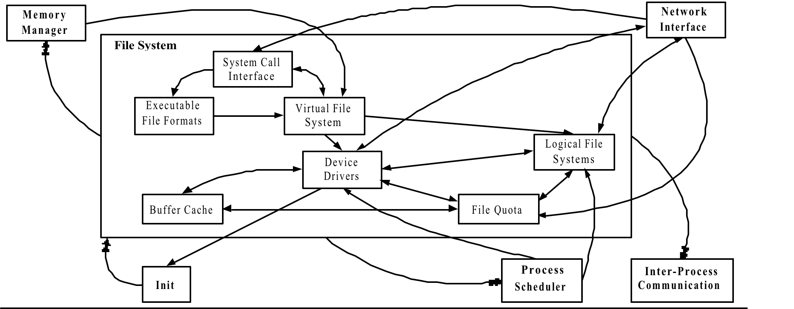
File System Concrete Architecture

Slide 29
File System Concrete Architecture (cont’d)
Same subsystems.
Also has substantially more dependency relations. Why?
Missed dependencies in the documentation.
Functionality that was implemented in multiple subsystems.
Unexpected control flow implementations.

Slide 30
File System Concrete Architecture (cont’d)
Some unexpected relations:
Network Interface ➔ File System
The Network Interface directly calls functions in the implementation of two logical file systems (NCPFS, SMBFS).
Process Scheduler ➔ Device Drivers
A Process Scheduler routine calls a routine implemented within the Device Drivers.
File System subsystems ➔ IPC
Synchronization primitives are also used by the kernel.

Slide 31
Logical File System Concrete Architecture
Contains 17 different logical file systems.
They map logical files to physical locations on storage devices.
Has more dependencies than predicted in the conceptual architecture.

Slide 32
Takeaways
Automated tools are very important, but tools alone are not enough.
Human participation still required.
Source code examination is part of the deal
Remember: the architecture of a system is not “visible”.
Substantial differences between conceptual vs. concrete architecture
Missed the use of subsystems (e.g., IPC implements mechanisms used throughout the kernel).
Existing interfaces are bypassed for efficiency reasons.

Slide 33
Takeaways (cont’d)
The concrete architecture should be used to refine the conceptual architecture.
May not be desirable to add all relations
Many are not essential and hinder system understanding.
Concrete architecture identifies potential improvements.

